Slide 1
Managing Hypertension
A Presentation for the Provider Community
Developed by:
Department of Vermont Health Access (DVHA)
Vermont Department of Health (VDH) + Community Partners
Vermont Chronic Care Initiative (VCCI)
OneCare Vermont (OCV)
1/12/23

Slide 2
What We'll Cover
Health inequities that influence hypertension control
Performance measurement and monitoring for hypertension control
The purpose and core elements of developing a self-monitoring blood pressure program (SMBP) within your practice
Prescription for home-use blood pressure monitors and cuffs for patients with cost barriers (examples of completed forms will be provided)
Innovative approaches that local practices are implementing to improve blood pressure control
Locating resources on this topic
Notes:
Hello, everyone. It's great to be here. My name is Rebecca O'Reilly; I am the manager of Heart Disease and Diabetes Programs at the Vermont Department of Health, and it has been my pleasure to participate in the development of this webinar. Before we launch into content, we'll take a few moments to review what today's presenters will cover in an effort to add to your professional tool kit for helping patients manage hypertension. First, we'll take a look at some data to illustrate (bullet point 1)

Slide 3
Learning Objectives
Following today's webinar, you will be able to:
Identify several health inequities that influence hypertension
Summarize the key performance measurement strategy for hypertension control
Examine opportunities to include a self-monitoring blood pressure program (SMBP) within your practice
Use prescription to provide home-use blood pressure monitor + cuff to patients for whom cost is a barrier
Notes:
With today's agenda, it is our goal to help you achieve these four learning objectives. By the end of this presentation, it is our hope that you will be able to: (Bullet 1, 2, 3, 4...)
I will see you all again a few slides down the road, and in the meantime, it is my pleasure to introduce my heart disease and diabetes program colleague, Paul Meddaugh, to get us started.

Slide 4
Hypertension in Vermont
Hypertension in Vermont
Paul Meddaugh, Heart Disease & Diabetes Epidemiologist
Vermont Department of Health
Notes:
Hello, my name is Paul Meddaugh and I am the epidemiologist for the Heart Disease and Diabetes Program at the Vermont Department of Health where I have been in this role for going on 8 years now.
As an introduction to the importance of this topic, I’m going to briefly go over some important statewide hypertension data points.

Slide 5
Vermont Hypertension Prevalence
Source: Behavior Risk Factor Surveillance System (BRFSS), 2011-2020.
Notes:
As of 2020, 25% or around 129,900 Vermont adults have been diagnosed with hypertension.
You can see from this chart that the prevalence of hypertension has remained relatively unchanged over the last decade.
The hypertension prevalence among Vermont adults in 2019 is significantly lower than U.S. adults.

Slide 6
Health Inequities and Hypertension
Hypertension is significantly more likely among adults:
With any disability.
With poor mental health.
Living at a low or middle SES compared to a high SES.
Living in a small rural town compared to an urban one.
Disability
Poor Mental Health
Sexual Orientation/Gender Identity
Race/Ethnicity
Source: VT Behavior Risk Factor Surveillance System (BRFSS), 2020.
Socioeconomic Status (SES)
Geographic Isolation
Notes:
Hypertension does not impact everyone the same. Hypertension is significantly more likely among Vermont adults who have any disability, have poor mental health, live at a low or middle socioeconomic status compared to those living at a high one, and it’s significantly more likely among those living in a small rural town, which are low population areas of 2,500 to less than 10,000 people where 30%-50% of commuting primarily occurs in similar sized areas or areas of higher population density and urbanization, compared to an urban one.

Slide 7
Vermont Hypertension Primary Care Visits
The rate of primary care visits for hypertension among insured Vermonters has trended down since 2018.
Source: GMCB Vermont Health Care Uniform Reporting and Evaluation System (VHCURES), 2011-2020 – extract 3005 – extracted 10/25/22.
*Comparisons 2015 and earlier to post-2015 should be made with caution due to changes in the number of private payers submitting to VHUCRES beginning in 2016.
All analyses, conclusions, and recommendations provided here are solely those of the Department of Health and not necessarily those of the GMCB.
Notes:
In 2020, there were 285.9 visits for hypertension out of every 1,000 Vermont insured persons. This represents 187,066 visits among 87,225 people.
On average, there were 2.1 primary care visits per Vermont insured person in 2020.
The 2020 rate was statistically lower than all previous years from 2016 to 2019. This decrease is largely attributed to the decreased healthcare utilization during the COVID-19 pandemic. A big concern of that being whether decreased healthcare visitation led to decreased hypertension control. We have some evidence indicating that control has gone down but, we don’t have statewide data on that to be able to describe control rates among all Vermonters.

Slide 8
Hypertension-Related Mortality
The rate of all hypertension-related deaths among Vermonters is significantly higher than hypertension as the primary (principal) cause for death.
This indicates that the burden of hypertension is as a contributing factor to disease.
Source: VT Vital Statistics, 2010-2020.
Notes:
As a primary cause of death, which is the immediate medical cause resulting in death, hypertension has significantly increased since 2010 but has remained statistically unchanged since 2017.
All hypertension-related deaths, which is any death where hypertension was the immediate cause resulting in death or a contributing factor to what was the immediate cause of death, has shown an overall ascending trend since 2010. In 2020, it significantly increased from 2019 and is statistically higher than all preceding years going back to 2010.
This indicates that the main burden of hypertension is as a contributing factor to other health issues.

Slide 9
Self-Measured Blood Pressure Monitoring Programs (SMBPs)
Implementation of SMBPs have increased at VDH partnering health centers from 2020-2022.
Blood pressure monitor loaner libraries have increased over time among health centers with an SMBP.
75%
100%
100%
Source: Vermont Health Systems Quality Improvement Assessment (VHSQIA), 2020-2022.
*In 2020, fewer (N = 6) health centers were working on heart disease prevention strategies than in subsequent years (N = 8, 2021 and 2022), as a result, this value reflects only those working on heart disease strategies in 2020.
Notes:
The Department of Health’s Heart Disease and Diabetes Program has been partnering with 8 health centers throughout the state since 2019 to work on a number of heart disease prevention strategies including hypertension control; They include 6 FQHCs and 2 hospital-owned practices that cover about 72,000 adults between the ages of 18 and 85, around 26,000 of whom are diagnosed with hypertension. You’ll be hearing from two of these health centers shortly.
The proportion of partnering health centers that have implemented a self-measured blood pressure monitoring program has increased over the duration of the partnership from 67% in 2020 to 89% in 2022.
In order to participate in SMBP, individuals will need access to a blood pressure cuff. Some will not be able to afford to purchase their own and while some insurers, including Medicaid, will cover one, not all insurers do. Offering a blood pressure loaner cuff can provide the necessary access to facilitate self-monitoring. By 2021, the proportion of partnering health centers with a BP monitor loaner library increased to 100% and sustained at 100% in 2022.
Now I’m going to pass it off to my colleague Erin Carmichael from DVHA who will talk about some Medicaid specific data.

Slide 10
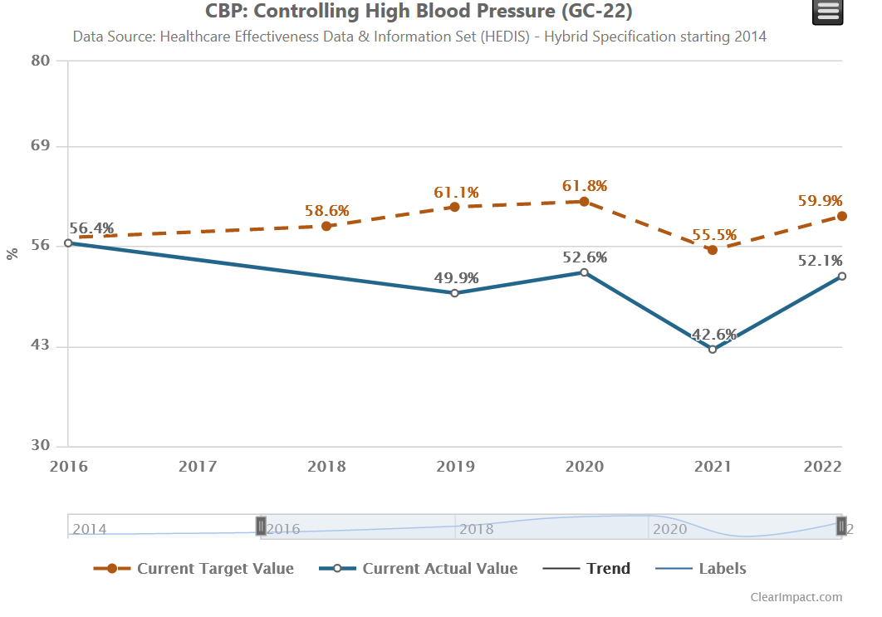
A Closer Look: Vermont Medicaid
The blue line shows the percentage of Vermont Medicaid members 18-85 years of age who had a diagnosis of hypertension and whose blood pressure was adequately controlled (<140/90mm Hg) during the previous year.
The red dotted line displays the national 50th percentile for Medicaid programs. The blue line is Vermont's actual performance.
Notes:
This graph shows Vermont Medicaid's performance on a national measure for health plans called Controlling High Blood Pressure, or CBP. It requires clinical information (blood pressure measurements) from medical records to be calculated accurately. Health plans take a sample of individuals who have been diagnosed with hypertension and find the most recent blood pressure readings in their medical record. Individuals with readings of less than 140/90 are "counted" as having their blood pressure in control. You can see that Vermont Medicaid (the solid blue line) performs below the national 50th percentile (the red dotted line) for Medicaid programs.

Slide 11
HBPM & Measuring Performance
Home Blood Pressure Monitoring Now Part of Annual CBP Performance Measure
Starting in 2021, the NCQA revised the HEDIS measure on Controlling High Blood Pressure to include remote blood pressure monitoring readings
This underlines the importance of encouraging the use of home blood pressure monitors and documenting those readings during telehealth visits and other patient transmissions or encounters
Remote Blood pressure readings done at home can be captured during a follow-up in-person office visit, telehealth visit, telephone visits, e-visit, or virtual visit.
Patient-reported readings taken with a digital device are acceptable and should be documented in the medical record along with the date.
Providers don’t need to see the reading on the digital device; the patient can verbally report it
This information, and more, can be found on the Hypertension
Provider & Patient Tip Sheet
Notes:
As I mentioned in the previous slide, the CBP measure takes documented blood pressure readings into consideration. And starting in 2021, NCQA revised the measure specifications to include readings taken at home with an automated blood pressure monitor. It’s important for providers to capture these home readings in the patient’s medical record.
https://www.ama-assn.org/delivering-care/hypertension/what-you-need-know-about-self-measured-blood-pressure-monitoring

Slide 12
Project Work: Interventions so far
Our project strategies have revolved around:
making automatic blood pressure devices with cuffs more accessible and affordable
Expanded ICD-10 diagnosis codes (clinical criteria)
encouraging patients to join educational workshops that promote the importance of self-monitoring BPs
www.MyHealthyVT.org
raising awareness among providers about measuring, diagnosing and documenting these BP reading in patient charts
Developed a Provider/Patient Tip sheet (click here)

Slide 13
Clinical Checklist
Send Progress Note to support diagnosis and need for frequent monitoring (clinical criteria)
Send prescription with diagnosis of XXX, prescription: “automatic BP device with cuff” (and specify if small or extra-large is needed), quantity #1
Send completed DME form

Slide 14
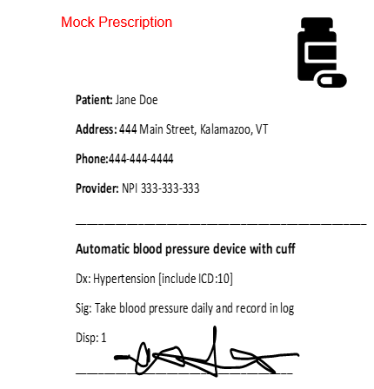
Clinical Slide – Prescription Example
Prescription should include:
Diagnosis with ICD 10 code
Sig: Automatic blood pressure device with cuff. Include directions.
If larger or small cuff indicated please sure to ensure include in prescription ie, Auto BP cuff with X large cuff. (Avg size cuff 9” to17” in circumference.)

Slide 15
Cuff Sizes
*Bladder and cuff size may differ by manufacturer.
Source: Table 3: Muntner P, Shimbo D, Carey RM, Charleston JB, et al. Measurement of blood pressure in humans: a scientific statement from the American Heart Association. Hypertension. 2019;73:e35–e66. doi: 10.1161/ HYP.000000000000008.

Slide 16
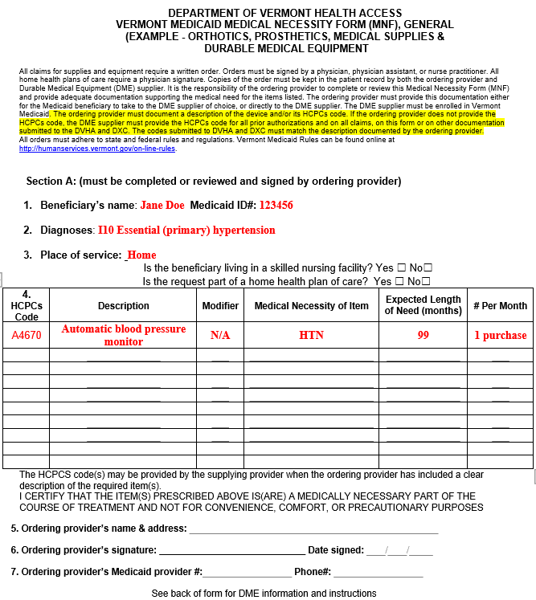
DME Form
The ordering provider must document a description of the device and/or its HCPCs code.
If the ordering provider does not provide the HCPCs code, the DME supplier must provide the HCPCs code for all prior authorizations and on all claims, on this form or on other documentation submitted to the DVHA and DXC.
The codes submitted to DVHA and DXC must match the description documented by the ordering provider.

Slide 17
Core Elements of an SMBP Program
Practice
Practice Protocol: Implement a protocol with a defined workflow, patient eligibility, and action steps.
Prepare
Prepare Team for engagement: identify team members, standardize training, establish buy-in
Determine
Determine Clinical support system: Use an existing model, establish a feedback loop, ensure IT components are in place
https://millionhearts.hhs.gov/files/MH_SMBP_Clinicians.pdf
Notes:
Hello again, everyone. We've talked a lot so far about disparity that exists in the world of chronic conditions management, in-particular, controlling hypertension. We have also explored some ways to begin to ameliorate some disparity, such as providing BP monitors and cuffs to those who may have difficulty purchasing out of pocket. Now we will take a step back and take a quick look at another key component of addressing disparity and supporting hypertension control: Establishing a program that supports patient self-monitoring of blood pressure. We will briefly review these steps, all of which will be made available to you after this presentation, and then we will hear directly from a couple of Vermont practices who have successfully integrated programs into their own clinics.
So, according the Million Hearts Action Guide for Self-Measured Blood Pressure Monitoring, the core elements of an SMBP include these steps:

Slide 18
Core Elements of a SMBP Program cont.
Empower Patients: Explain the process and train patients on the correct technique
Include written guidance and a link or video in the patient portal
Establish the easiest and most hassle-free process to get an SMBP unit to patients
Tracking method for patients (online / paper/ etc.)
Establish a reliable process to get SMBP values back into EMR
Work with billing /coding to maximize reimbursement and minimize patient costs
https://millionhearts.hhs.gov/files/MH_SMBP_Clinicians.pdf
Notes:
Easy, right?

Slide 19
Clinical Flow
https://millionhearts.hhs.gov/files/MH_SMBP_Clinicians.pdf
Notes:
This busy looking slide shows a sample protocol as could be developed per the first step in the core elements of developing an SMBP program. As you can see, it includes elements to connect patients to community programming for an additional layer of support. This example uses the YMCA, but here in Vermont, My Healthy VT, which Kristie mentioned earlier, is available to all Vermonters, free of charge. Patients can be referred to MHVT's blood pressure management workshops at www.myhealthyvt.org (link can be found in the resources slide). The VDH heart disease and diabetes program, supported by a CDC cooperative agreement, provides grant funding to several healthcare practice networks within Vermont to develop and continuously improve workflow protocols. Now we will hear from two of those practices and how they have approached some of these core elements. First, we will hear from Pam Jacobs with Norther Tier Center for Health, and then we will hear from Michelle Martelle with Community Health Centers of Burlington. I will let them each introduce themselves when they begin. Pam and Michelle, thank you so much for being here. Pam, take it away whenever you're ready.

Slide 20
NOTCH: Issuing and Tracking
Issuing and Tracking SMBP devices:
Complete device loaner agreement, scan copy into patient’s chart “SMBP-Loan”(or generate from patient chart and have electronically sign) and give patient a copy
Create a ToDo in the patient’s chart and assign the user as the clinic’s nurse triage account
Assign reason as “SMBP” (allows a way to track patients that are participants in SMBP program)
Set ToDo date for return date as discussed with the patient (4 weeks)

Slide 21
NOTCH: Data Collection
Using a smartphone app linked to the SMBP device the patient can send home BP reading to a specified NOTCH email.
(These emails are received by care coordination, saved as a pdf in the EHR labeled “SMBP pt scanned data” and then routed to the provider. The document can be tracked using a DM/HM report in Medent. BP results are entered into the vital section of patient’s chart)
Using the patient portal, the patient can enter the home BP readings and send directly to their clinic. Nursing should accept the data and it will automatically be entered as data into the patient’s vitals record.
Patient can schedule a 28-day BP check with nursing, at time of receiving SMBP device, if no future appointments are scheduled with their provider. Patients are asked to bring BP readings to follow up appointment or drop them off at office in a specified time. These readings are entered into chart. All appointment types can be tracked and extrapolated in a report.
Provide a pre-stamped envelope and form to complete to send results back. A document is created in Medent titled “BP readings” which, once created and closed, can be tracked through Medent reporting.

Slide 22
NOTCH: Using EHR to Follow Up
EHR Reports:
Identify participation
Differentiate BPs readings in office versus at home
Identifying patients with dx of HTN and not seen in office in past 6 months
Identify participants of program who have not been seen or provided BP readings
Identify patients who are due to return device
Current Data: 800 patients have enrolled
Over 4880 have been offered (either have home BP device or declined to participate)

Slide 23
Prescribing Blood Pressure Cuffs
Prescriptions for BP cuffs need to be filled at a medical supply store and require a DME
Only one store in Chittenden County will currently fill /bill Medicaid

Slide 24
Blood Pressure Cuff Lending Libraries
Started at Champlain Islands site due to lack of pharmacies, lack of insurance coverage
Expanded to other sites based on interest/need/capacity
Currently we have lending libraries at two sites and for two specific populations; those receiving home care and pregnant patients
Variation in how programs were implemented across sites; attempting to standardize while keeping implementation barriers low
Use of EHR med module to prescribe in-house cuffs
Development of organization-wide protocol to guide sites implementing a lending library

Slide 25
Resource Slide
Clinical criteria
Cuff size resource
Gainwell rep link
Measurement of Blood Pressure in Humans: A Scientific Statement From the American Heart Association | Hypertension (ahajournals.org)
MyHealthyVT.org
Provider & Patient Tip Sheet
Self-Measured Blood Pressure Monitoring for Clinicians (Million Hearts)

Slide 26
Questions?
Primary Contacts:
Erin Carmichael
Director of Quality Management, DVHA, Erin.Carmichael@vermont.gov
Rebecca O'Reilly, MS, RD
Manager, Heart Disease and Diabetes Programs, VDH, Rebecca.OReilly@vermont.gov

